Slide 1
G107 Effective
Communication
P06
What are you Asking?
6TH PRESENTATION

Slide 2
Learning Outcomes
1. Identify and describe the types of questions.
2. Explain the link between question type and purpose.
3. Craft a set of questions with clear objectives (purpose).

Slide 3
Problem Analysis
Types of questions
The fight: Who is at fault?
Link between question type & purpose
How do we craft questions with a certain objectives in mind?
Language used
How should we use words/phrases so that questions are clear and unbiased?
How does language affect the tone of the question?
Does the sequence of questions matter?
What are the types of questions to help us find out?

Slide 4
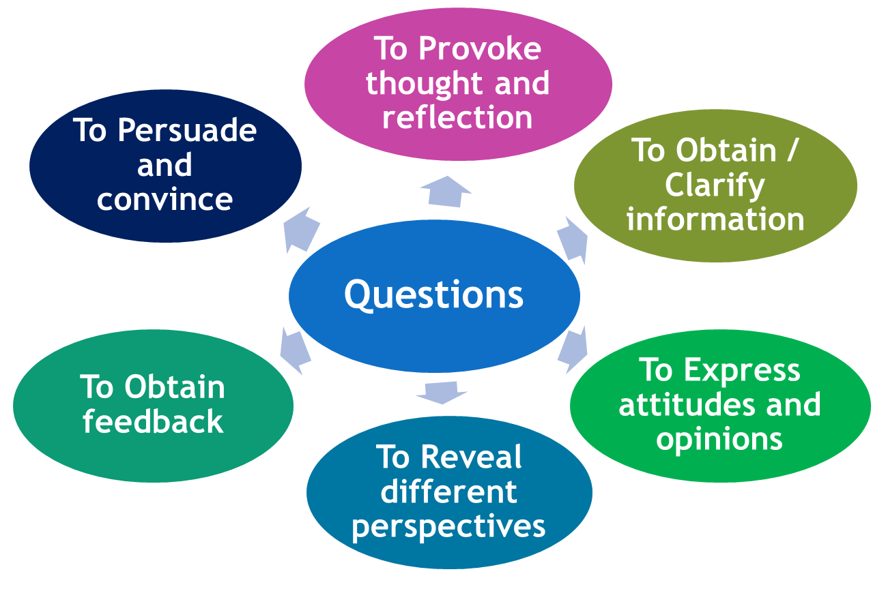
Purpose of asking Questions

Slide 5
Purpose of Question Types
Open-ended: encourage more responses
Example: ‘What happened?’ or ‘Why?’ or ‘How?’
Close-ended: seeking short, specific answers
Example: ‘Is it true that..?’ or ‘Do you know..?’
Ambiguous: vaguely phrased, opening up possibility for multiple interpretations
Example: ‘Did you give her cat food?’ or ‘What is your marital status?’

Slide 6
Purpose of Question Types
Clarifying: confirming the listener’s understanding,
clarifying a vague response
Example: ‘Did you say that this cost $5?’ or ‘What did you mean by that?’
Double-barreled: contains two parts in one question
Example: ‘How do you feel about gun control and the right to protect yourself?’
Embarrassing: to cause awkwardness from respondent
Example: ‘When did you last steal?’

Slide 7
Purpose of Question Types
Leading: suggesting desired answers
Example: ‘You said this, didn’t you?’
Probing: seeking additional information
Example: ‘Do you think that …?’ or ‘Where were you on 5th of March 2017?’
Rhetorical: looks like a question but is not. It is asked for effect, used to express sender’s opinion. There are two types:
Questions with obvious answers
Example: Do pigs fly? Is the pope Catholic?
Questions that have no specific answers
Why me? What is the meaning of life?

Slide 8
Purpose of Question Types
Note: A question can fit more than 1 question type.
Example: Adrian, isn’t it true you lied to the police officer about the accident? (Close-ended / Embarrassing / Leading)

Slide 9
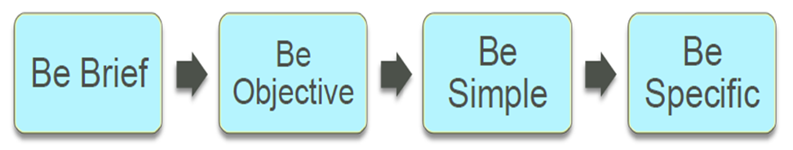
Drafting Questions
Be Brief – Keep questions short and ask one question at a time. Longer questions may quickly become confusing, thus resulting in confusion of what you are asking.
Be Objective – Make sure to pay attention to the neutrality of the words.
Be Simple – Questions should use language that is simple in both words and phrases.
Be Specific – Avoid using words like ‘often’, ‘usually’, ‘generally’, etc. as these words are subjective. ‘Often’ to one person may be once or twice a week and to someone else it could be a few times a month.

Slide 10
Advantages & Disadvantages of Questions
Question Types | Advantages | Disadvantages
Close-ended/Closed questions | can be used to good effect to obtain specific, concise information can be used to regain control from a talkative person to direct the interview to specific areas or to introduce a more open question. | too many closed questions can seem like an interrogation can disadvantage shy or nervous candidates by not encouraging them to expand not appropriate if you are trying to get the interviewee to talk in depth about their experience or attitudes.
Open-ended questions | encourages the interviewees or respondents to do most of the talking may turn up unexpected areas for the interviewer to pursue allows the respondents to talk about topics in their own words good for exploring opinions, attitudes and feelings. | can be difficult to phrase succinctly can leave the respondent floundering and unsure of the expected answer.

Slide 11
Advantages & Disadvantages of Questions
Question Types | Advantages | Disadvantages
Clarifying Questions | useful when you want to gain quick confirmation of basic facts are useful for clarifying a vague response. | not appropriate if you are trying to get the interviewee to talk in depth about their experience or attitudes.
Probing Questions | particularly useful for encouraging people to concentrate on specific points, for testing the validity of a more general response and seeking evidence. | if overused, can leave the respondent unsure of the expected answer or feeling that they must have given an incorrect response.

Slide 12
Advantages & Disadvantages of Questions
Question Types | Advantages | Disadvantages
Embarrassing Questions: when questions asked cause awkwardness for the respondent | useful when there is a need to put the respondent in a difficult position, to gauge their response can be used in a high-stress interview when a respondent is required to remain calm and composed | it can be offensive and seen as a personal attack it is not always ethical
Ambiguous Questions: when the meaning of the question is unclear because of phrasing or word choice for instance “what is your marital status?” | useful when there is an intention to confuse the respondent can be used to mask the real intention of the question and catch the respondent off guard | it causes confusion and prevents the respondent from answering the question not an efficient use of time

Slide 13

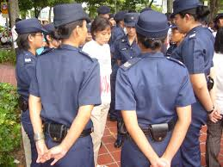
i. What were you doing at Orchard Central?
ii. How did the incident happen?
Open-ended question to gather more facts.
i. What happened when the Grabdriver stepped out of his car?
ii. Did you spit on his car?
Open-ended, probing questions to determine events.
i. Is your medical condition under control?
ii. Why did you miss your doctor’s appointment?
Closed, probing questions to obtain specific information.
Close-ended, to confirm a fact.
Open-ended, probing.

Slide 14
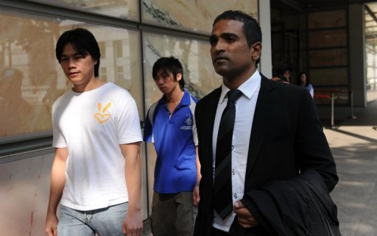

Adrian, can you tell us what happened in the incident?
Open-ended question to allow Adrian to tell his account.
i. Adrian, what did you do to get Benny’s attention?
ii. Did you intend to hurt Benny?
Open-ended, leading question to show that Adrian was carrying out his duties as a CISCO guard.
Benny, is it true that you get agitated easily when you miss your medication?
Close-ended, leading question to discredit Benny.
Close-ended, to prove lack of intent to cause hurt.

Slide 15

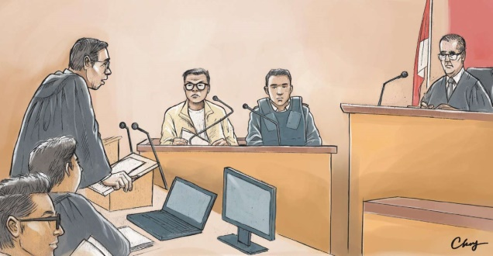
i. Adrian, were you in a bad mood the day of the accident?
ii. Do you have a bad temper?
Close-ended, leading question to get facts, discredit Adrian.
i. Benny, did the CISCO guard signal you to step out of your car?
ii. What happened next?
Close-ended and Open-ended clarifying questions to clarify facts.
Open-ended, probing question to allow Benny to explain his views on Adrian.
Benny, could you describe how you felt when Adrian approached you?

Slide 16
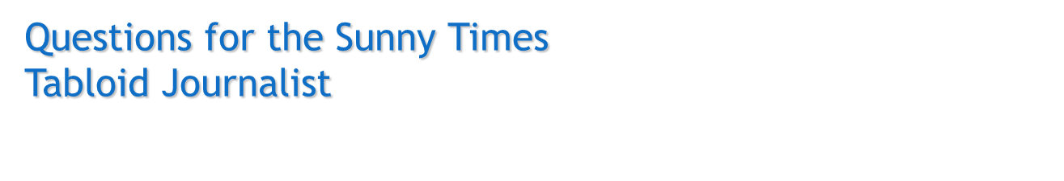
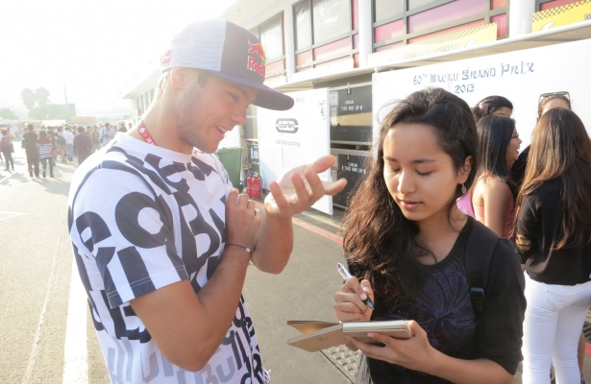
Adrian, when was the last time you hit someone when you were angry?
Closed, embarrassing question to fish for potential gossip.
Adrian, were you stressed by your unreasonable working hours?
Closed-ended, leading question to entice Adrian to share more.
Benny, what usually happens when you cannot control your anxieties?
Open-ended, leading question that suggests Benny cannot control his OCD condition.

Slide 17
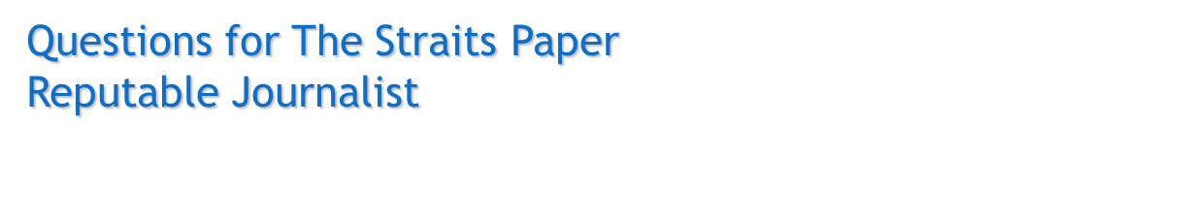
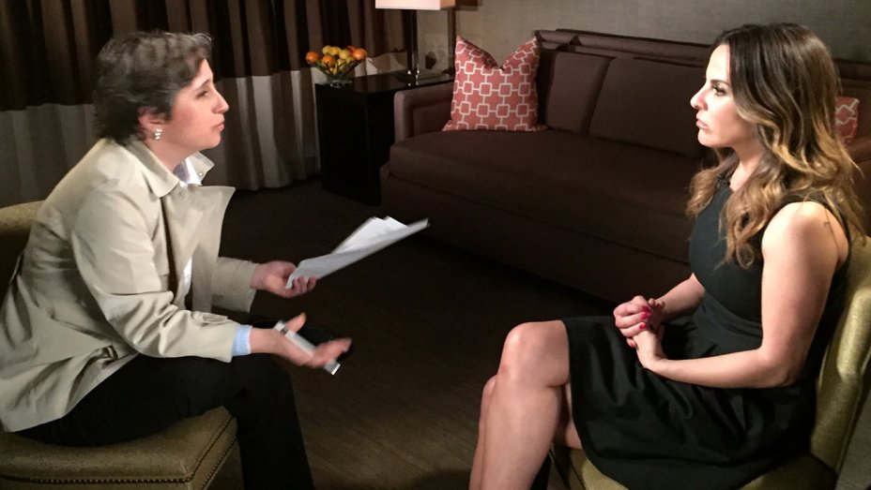
Adrian/Donnie, what happened that evening?
Open-ended question.
Adrian/Donnie, were there any eye witnesses to the accident? /
When is the hearing date scheduled for this case?
Close-ended, probing question to seek specific facts.
i. Is this the first time you are involved such incidents? /
ii. What was the reaction from your family and friends?
i. Close-ended / ii.Open-ended, probing questions to seek emotional response.

Slide 18
Question Types to Avoid
Question Type | Possible Questions
Embarrassing questions: framed in a way that causes awkwardness for the respondent | Adrian, when was the last time you hit someone when you were angry? Adrian, when was the last time you lost your temper? Benny, when was the last time you could not control your compulsion? Benny when was the last time you forgot to take your medication for your OCD?
Ambiguous questions: framed such that there is more than a single way to interpret it. The meaning of the question is unclear because of phrasing or word choice. | It was out of control, right? [‘it’ is unclear. It could refer to the situation or a person] Benny, what was it about him that made you so anxious/mad? [posed by the tabloid journalist]: the question could refer to Adrian or the Grab passenger.
Double-barrelled questions: framed such that the question contains two distinct and separate parts. | Adrian, were you angry that Benny did not respond to you earlier and you decided to hurl vulgarities at him? Benny, were you upset that Adrian spat on your car and you were out of control because you did not take your medication?

Slide 19

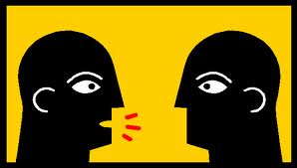
Questioning and Listening Skills
You did it didn’t you?
Is he saying I did it?
CHANNELS
MESSAGE
CHANNELS
SENDER
RECEIVER
SENDER
RECEIVER
CONTEXT
Listening involves (a) Processing what is being said (b) Understanding (c) Making meaning before (d) Responding to what is said.

Slide 20
Concept Diagram
Question Types
Open-Ended
Closed-Ended
Ambiguous
Clarifying
Double-barreled
Embarrassing
Probing
Leading
Rhetorical

Slide 21
Reference
Interrogation Questions. Retrieved September 20, 2017 from Changing Minds website. http://changingminds.org/techniques/interrogation/interogation_questions.htm
Interview-Questions-Answered.net (n.d.). What is the likely order of questions? Retrieved from http://www.interview-questions-answered.net/top-100-questions.html
Examining Witnesses - Examination-in-chief. (n.d.). Retrieved September 20, 2017 from Law Teacher website, http://www.lawteacher.net/Advocacy/examination-in-chief.php#ixzz2C66vIBwq
The Law Society of Singapore (2004). Examination-in-Chief in PLC Advocacy Training 2004, Materials for PLC Students. Retrieved September 20, 2017 from http://www.lawsociety.org.sg/

